Slide 1

Healthcare Beyond Borders Case Study on Expanding Internationally
Megha Dwarakanath

Slide 2

WHO ARE WE? Introducing the Experts Behind the Analysis
Megha Dwarakanath(Member ID : 63):
BE in Computer Science, MBA in International Business
DevOps Engineer in SAP Labs, Aspiring Business Analyst
Megha.dwarakanathk@gmail.com
Tarun Patel (Member ID : 193):
BE in Computer Science
SRE in Akamai, Aspiring Data Analyst
tarunpatel216@gmail.com

Slide 3
Overview of gloBalmed HEALTH SYSTEMS
GlobalMed Health Systems, a leading healthcare provider based in the United Kingdom, is renowned for its state-of-the-art hospitals and exceptional patient care. With a reputation for delivering innovative healthcare solutions, GlobalMed has established itself as a trusted name in the industry, operating over 50 hospitals across the UK.
As the company looks to expand its reach beyond its established UK base, there is a critical need to identify and enter international markets that exhibit substantial demand for high-quality healthcare services.
CASE STUDY OBJECTIVE

Slide 4









Market selection criteria
Health per capita expenditure (A)
Health expenditure as % of GDP (B)
Physician per 1000 People (G)
Hospital Beds per 1000 People (E)
Life expectancy at Birth (H)
% of people in age group 15 – 65 (I)
% of people of age 65 and above (F)
Overall GDP (C)
Overall Population (D)
Weight represented as w1, w2, w3 and so on
Scores are calculated on the scale of 1 to 10
ECONOMIC VIABILITY SCORE = (w1 * A + w2 * B + w3 *C + w4 *D) / (w1+w2+w3+w4)
DEMAND SCORE = (w5 * E + w6 * F + w7 * G + w8 * H + w9 * I) / (w5+w6+w7+w8+w9)
COMBINED SCORE = (w10 + Economic Viability Score) + (w11 + Demand Score)

Slide 5
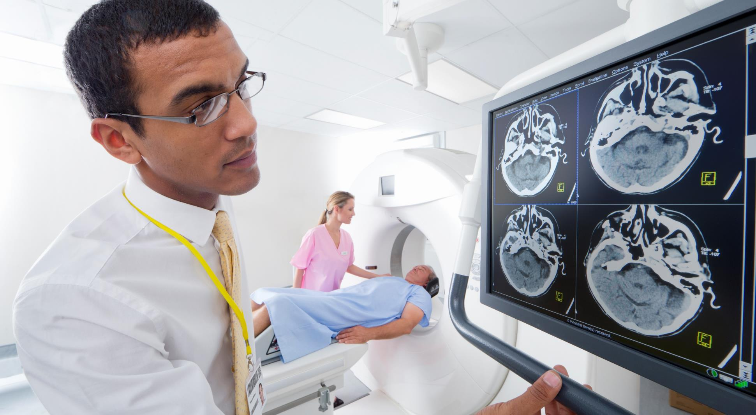
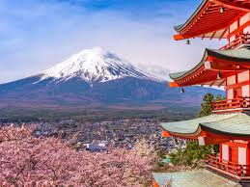
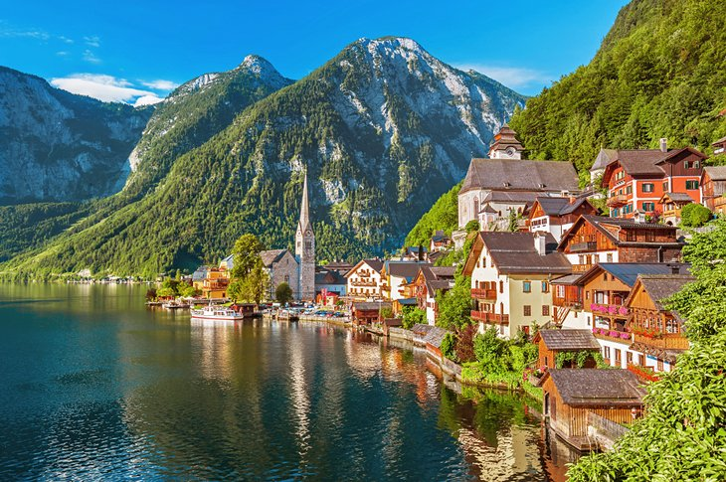

Selected countries
1. JAPAN
2. AUSTRIA
3. SWITZERLAND

Slide 6


OTHER POTENTIAL countries
4. NORWAY
5. FANCE

Slide 7
DEMAND AND ECONOMIC VIABILITY SCORE
Country Name | Demand Score | Economic Viability Score | Combined Score
United Kingdom | 5.621 | 2.636 | 4.278
North America | 5.653 | 5.816 | 5.726
United States | 5.581 | 5.881 | 5.716
Japan | 7.684 | 2.575 | 5.385
Germany | 6.977 | 3.217 | 5.285
Austria | 7.022 | 2.786 | 5.116
Switzerland | 6.395 | 3.255 | 4.982
Cuba | 7.175 | 2.041 | 4.865
Norway | 6.297 | 2.955 | 4.794
Korea, Rep. | 7.161 | 1.873 | 4.781
France | 6.345 | 2.836 | 4.766
Belgium | 6.342 | 2.711 | 4.708
Malta | 6.655 | 2.181 | 4.642
Sweden | 6.119 | 2.764 | 4.609
Netherlands | 6.011 | 2.759 | 4.548

Slide 8
SWOT ANALYSIS
GLOBALMED HEALTH SYSTEM
STRENGTH - Strong brand reputation in the UK for advanced care and patient outcomes. - Expertise in managing state-of-the-art facilities. - High-quality medical technology and infrastructure. - Skilled workforce with a patient-centric approach. | WEAKNESS - High operating costs associated with expanding into foreign markets. - Limited local knowledge of market dynamics in the target countries. - Potential regulatory challenges across multiple regions. - Cultural adaptation to different healthcare systems
OPPORTUNITIES - Expansion into high-demand healthcare markets with aging populations. - Partnership opportunities with local healthcare institutions. - Increasing demand for specialized healthcare and medical tourism. - Potential for leveraging telemedicine and digital health services. | THREAT - Intense competition from established local healthcare providers. - Stringent government regulations and healthcare policies. - Economic instability or political risks in foreign markets. - Potential cultural differences in healthcare delivery expectations.

Slide 9
Risk Analysis
Healthcare Industry
1. Regulatory and Compliance Risks
Risks: Non-compliance with laws and regulations like HIPAA (Health Insurance Portability and Accountability Act), FDA guidelines, CMS (Centers for Medicare & Medicaid Services) regulations, etc.
Potential Threats:
Regulatory fines or penalties.
Loss of accreditation or licensure.
Legal liabilities due to non-compliance.
2. Operational Risks
Risks: Disruptions to day-to-day operations that affect patient care, workflow, or service delivery.
Potential Threats:
Workforce shortages or turnover (e.g., nurses, doctors).
Inefficient hospital management or patient flow.
Equipment failure or supply chain interruptions.

Slide 10
Risk Analysis
Healthcare Industry
3. Cybersecurity Risks
Risks: Threats to healthcare information systems and patient data security.
Potential Threats:
Data breaches.
Ransomware attacks.
Phishing schemes targeting staff.
4. Financial Risks
Risks: Financial management challenges that affect the profitability and sustainability of healthcare organizations.
Potential Threats:
Rising operational costs (staff salaries, equipment, drugs).
Reimbursement changes (Medicare/Medicaid).
Unforeseen expenses (litigation, fines).

Slide 11
Risk Analysis
Healthcare Industry
5. Legal and Liability Risks
Risks: Exposure to lawsuits, legal actions, or claims related to patient care or workplace incidents.
Potential Threats:
Medical malpractice claims.
Workplace accidents or injuries.
Disputes with vendors or partners.
6. Patient Safety and Care Risks
Risks: Factors that negatively impact the quality of patient care.
Potential Threats:
Medical errors or misdiagnosis.
Infections or complications during treatment.
Poor communication between healthcare providers and patients.

Slide 12
Risk Analysis
Healthcare Industry
7. Technological Risks
Risks: Dependency on technology for delivering healthcare services.
Potential Threats:
Technology failure (EMRs, diagnostic tools).
Insufficient tech support or outdated systems.
Data management and integration challenges
8. Environmental and External Risks
Risks: External factors that may disrupt healthcare operations.
Potential Threats:
Natural disasters (e.g., floods, earthquakes).
Pandemics or disease outbreaks.
Socio-political unrest affecting healthcare delivery.

Slide 13
Risk Analysis
Healthcare Industry
9. Reputation Risks
Risks: Damage to the reputation and public trust of healthcare institutions.
Potential Threats:
Negative media coverage.
Poor patient outcomes or experiences.
Public scandals (e.g., data breaches, fraud).
10. Human Resources Risks
Risks: Workforce management challenges that can impact healthcare delivery.
Potential Threats:
Burnout and stress among healthcare workers.
Labor strikes or union disputes.
Diversity and inclusion challenges.

Slide 14
Gap Analysis
JAPAN
Current Providers: Notable players include Nihon University Itabashi Hospital, Tokyo Medical University Hospital, and Kobe University Hospital. These hospitals have a strong domestic presence and are highly competitive.
Gap: High demand for aging care and specialized treatments like oncology and cardiovascular care due to Japan's aging population. Gaps exist in digital healthcare infrastructure and advanced medical technologies.
Opportunity for GlobalMed: Introducing high-tech healthcare solutions (e.g., telemedicine), and providing specialized care that addresses chronic conditions in the elderly.

Slide 15
Gap Analysis
Austria
Current Providers: Key players include Vienna General Hospital and Salzburg University Hospital. Austria’s healthcare system is well-developed, with a high level of public healthcare provision.
Gap: A growing need for private healthcare options and specialized services such as cosmetic surgery, orthopedics, and rehabilitation care.
Opportunity for GlobalMed: Establishment of private healthcare facilities catering to higher-end clients, and providing specialized medical treatments that complement Austria’s public system.

Slide 16
Gap Analysis
SWITZERLAND
Current Providers: Major players include University Hospital Zurich and Inselspital in Bern. Switzerland’s healthcare system is known for its high quality, with a mix of public and private providers.
Gap: Switzerland has a well-established healthcare system, but there is an increasing demand for premium healthcare services and medical tourism.
Opportunity for GlobalMed: Focus on premium healthcare and specialized treatments, particularly in cancer care and medical tourism for international patients seeking advanced medical procedures.

Slide 17
Gap Analysis
NORWAY
Current Providers: Public hospitals like Oslo University Hospital dominate the market. Norway has a universal healthcare system with a focus on equitable access.
Gap: Private healthcare is underdeveloped compared to other European countries, and there’s room for improvement in specialized care such as mental health and advanced diagnostics.
Opportunity for GlobalMed: Developing private healthcare facilities offering high-quality, specialized services in areas like mental health, rehabilitation, and chronic disease management.

Slide 18
Gap Analysis
FRANCE
Current Providers: Leading institutions include Assistance Publique - Hôpitaux de Paris (AP-HP) and Hôpital Pitié-Salpêtrière. France has a well-regarded public healthcare system, but private healthcare is growing.
Gap: Increasing demand for private healthcare options, particularly in cosmetic surgery, rehabilitation, and geriatrics
Opportunity for GlobalMed: Establishing private hospitals that offer specialized care and leveraging expertise in patient-centric care to cater to high-end clientele.

Slide 19
Potential Geological Merits and Demerits
Country | Merits | Demerits
Japan | Aging population, advanced infrastructure, strong demand for chronic care. | High operational costs, stringent regulations.
Austria | High healthcare standards, centralized healthcare policies, demand for private care. | Relatively small market size, high competition.
Switzerland | Medical tourism opportunities, stable economic environment, high demand for premium services. | High cost of entry and stringent regulatory environment.
Norway | Growing demand for specialized and private care, government support for innovation. | Limited private healthcare infrastructure, high regulatory control.
France | Strong demand for private healthcare, large population, well-developed healthcare system. | Bureaucratic challenges, high taxation and costs.

Slide 20
Current Healthcare Infrastructure
Country | Infrastructure Overview
Japan | Advanced healthcare system with a focus on aging care and digital health innovation.
Austria | Highly developed, publicly funded healthcare system with growing private sector influence.
Switzerland | World-class healthcare infrastructure, well-integrated private and public sectors.
Norway | Strong universal healthcare, with gaps in private healthcare facilities.
France | Comprehensive healthcare system with public dominance, but growing private sector.

Slide 21
Geo-political Laws
Country | Relevant Geo-Political Laws
Japan | Stringent foreign direct investment (FDI) regulations in healthcare, but liberalized rules for elderly care and digital health.
Austria | European Union regulations apply, but healthcare laws are relatively open to foreign providers.
Switzerland | Independent regulatory framework that supports medical innovation and foreign investments.
Norway | EEA laws apply, but Norway maintains autonomy in healthcare regulations, with an emphasis on equality.
France | Strict healthcare regulations, but there are favorable conditions for foreign investors in the private healthcare sector.

Slide 22
Government Regulations Supporting Healthcare Industry
Country | Healthcare Regulations
Japan | Strong regulatory control by Ministry of Health, Labour and Welfare; encourages elderly care innovations and telemedicine.
Austria | Healthcare is predominantly public, but private investments in healthcare are supported with favourable tax policies.
Switzerland | Federal Office of Public Health ensures high standards but supports private sector with medical tourism initiatives.
Norway | Government supports public-private partnerships (PPP) in healthcare innovation and emphasizes digital health.
France | Strong public healthcare system, but private hospitals are growing, and government support exists for innovation and public-private collaborations.

Slide 23
Medical Insurance and Healthcare Policies
Country | Type of Insurance | Cost-sharing | Private Insurance | Healthcare Focus
Japan | Public (NHI/EHI) | 30% (with caps) | Supplementary insurance for additional services | Aging population, chronic care, elderly support
Austria | Public (SHI) | Low (small co-payments) | Supplementary insurance for private services | Preventive care, well-developed public sector
Switzerland | Mandatory private insurance (MHI) | High (up to 30%) | Widely used for non-essential services | Medical tourism, private care
Norway | Public (NHI) | Low (annual cap) | Supplementary insurance (not widely used) | Equal access, telemedicine
France | Public (SHI) | 20-30% | Mutuelle insurance for uncovered costs | Primary care, chronic disease management

Slide 24
Cultural Factors in Healthcare
Country | Key Cultural Factors Affecting Healthcare | Impact on Healthcare Providers
Japan | Collectivist, respect for authority, aging population, mental health stigma, holistic approaches | Focus on elderly care, involve families in care, offer holistic options
Austria | High expectations from public healthcare, privacy concerns, preventive care focus | Offer preventive services, respect privacy, provide high-quality private care
Switzerland | Choice and autonomy, multilingual population, trust in institutions, medical tourism | Offer premium services, build trust, provide multilingual support
Norway | Equality in access, trust in public system, preventive care, mental health acceptance | Align with equitable healthcare values, emphasize preventive and mental health care
France | Patient-centric care, preventive care awareness, strong public healthcare, interest in alternative medicine | Offer patient-centered, premium services, and consider alternative treatments

Slide 25
Hiring and Professionals availability analysis
Country | Hiring & Professionals
Japan | Skilled workforce, but shortages in elderly care and nursing; open to foreign workers
Austria | Well-educated healthcare workforce; specialized field shortages in rural areas
Switzerland | Highly skilled, multilingual workforce; relies on foreign workers for rural areas
Norway | Well-trained, but shortages in specialists; depends on foreign workers
France | Strong workforce but nurse and GP shortages, especially in rural areas

Slide 26
Communication and Marketing Strategies
Country | Communication & Marketing Strategies
Japan | Emphasize trust, professionalism; digital marketing and traditional media are key
Austria | Focus on expertise, patient rights; online marketing with local expert partnerships
Switzerland | Multilingual marketing, focus on choice and quality; digital and medical tourism marketing
Norway | Emphasize equality, sustainability; digital-first marketing with inclusive communication
France | Focus on patient choice, innovation; multichannel approach with emphasis on high-quality care

Slide 27
Construction and Maintenance Analysis
Country | Construction Analysis | Maintenance Analysis
Japan | High costs due to seismic standards and high-tech requirements; labor shortages | Expensive maintenance due to aging infrastructure and need for skilled workers
Austria | Moderate costs with strong regulations; shortages in rural areas | Focus on preventive maintenance, sustainable systems, and energy efficiency
Switzerland | Very high costs, strict quality standards, and reliance on skilled labor | High-tech facility maintenance with an emphasis on preventive maintenance
Norway | High costs due to labor shortages and sustainability focus | Skilled workforce shortages, high maintenance costs for green technology
France | Moderate costs, regional differences in labor availability, rising urban costs | Strong focus on high-tech equipment and energy-efficient systems maintenance

Slide 28


CONCLUSION
JAPAN
Japan presents a highly attractive market for GlobalMed Health System due to its high demand for advanced healthcare services, driven by a rapidly aging population and a strong emphasis on cutting-edge medical technology. However, the market comes with challenges, including high construction and maintenance costs due to strict seismic regulations and a shortage of skilled healthcare professionals. Despite these challenges, Japan’s emphasis on technological innovation and its well-established healthcare infrastructure make it a top priority for expansion.

Slide 29
CONCLUSION
AUSTRIA
Austria offers a favorable environment for healthcare expansion with its well-educated workforce, moderate construction costs, and commitment to high-quality care. The country’s strong regulatory framework ensures safety and patient comfort, and its focus on sustainability aligns with GlobalMed Health System’s values. Austria’s growing demand for specialized healthcare services, particularly in rural areas, presents opportunities for GlobalMed to address gaps in the market. Austria's balanced approach to healthcare makes it a prime candidate for expansion.

Slide 30
CONCLUSION
SWITZERLAND
Switzerland stands out as an exceptionally high-value market due to its sophisticated healthcare system, strong emphasis on quality and safety, and a highly skilled workforce. The country’s stringent regulations and high construction costs are offset by its reputation for excellence and a robust healthcare infrastructure. The focus on sustainable building practices and advanced technology further aligns with GlobalMed Health System’s objectives. Despite the high costs, Switzerland's market potential and emphasis on medical innovation make it a key target for expansion.

Slide 31
CONCLUSION
Norway and France (POTENTIAL OPTION)
Norway and France also present viable alternatives, each with its unique set of advantages and challenges. Norway offers a focus on sustainability and a high standard of care, though it faces high construction costs and a shortage of skilled maintenance workers. France, with its moderate costs and emphasis on patient choice and innovation, provides a solid opportunity for GlobalMed Health System, despite regional variations in labor availability and healthcare infrastructure.

Slide 32


recommendation
Norway and France also present viable alternatives, each with its unique set of advantages and challenges. Norway offers a focus on sustainability and a high standard of care, though it faces high construction costs and a shortage of skilled maintenance workers. France, with its moderate costs and emphasis on patient choice and innovation, provides a solid opportunity for GlobalMed Health System, despite regional variations in labor availability and healthcare infrastructure.

Slide 33
Assumptions and Declaration
Tools Utilized in the Case Study
Power Query: For data extraction, transformation, and automation of data analysis.
Microsoft Excel: For data organization, calculations, and in-depth analysis.
Microsoft Word: For drafting and documenting the case study and supporting reports.
Microsoft PowerPoint: For creating the presentation and visualizing key findings.
PDF: For sharing finalized reports and presentations in a universally accessible format.
Assumptions made in the Case Study
As data for 2022 and 2023 were not available for all the datasets, all the calculations are done based on the latest data available
The Weights taken in for the calculations are based on the importance of the indicator that authors decided based on the Company’s goals
Though the case study requires only 3 countries, authors have added 2 more as other potential countries that can be considered

Slide 34
REFERENCES
World Health Organization (WHO) - Risk Management in Health Systems: WHO Risk Management
Centers for Disease Control and Prevention (CDC) - Healthcare Risk Management: CDC Risk Management
Healthcare Financial Management Association (HFMA) - Risk Management: HFMA Risk Management
Harvard Business Review - SWOT Analysis: HBR SWOT Analysis
MindTools - SWOT Analysis: MindTools SWOT Analysis
Forbes - Marketing Strategies in Healthcare: Forbes Marketing Strategies
Journal of Healthcare Management - Communication Strategies: Journal of Healthcare Management
World Health Organization (WHO) - Health Workforce: WHO Health Workforce
OECD - Health Workforce: OECD Health Workforce
Cultural Intelligence Center - Cultural Factors: Cultural Intelligence Center
World Health Organization - Culture and Health: WHO Culture and Health
OECD Health Policy Overview: OECD Health Policies
World Health Organization (WHO) - Health Financing: WHO Health Financing
European Union - Healthcare Regulations: EU Healthcare Regulations
National Government Websites: For country-specific regulations (e.g., Japan Ministry of Health, France Ministry of Health)
US Geological Survey (USGS) - Geology and Natural Hazards: USGS Geology
National Geographic - Earthquakes and Geology: National Geographic Geology
American Hospital Association (AHA) - Facility Planning and Management: AHA Facility Planning
Health Facilities Management - Construction Trends: HFM Construction

Slide 35

Thank you
Megha Dwarakanath & Tarun Patel

